Slide 1
Predict CLTV of a Customer

Slide 2
Problem Statement
VahanBima is one of the leading insurance companies in India. It provides motor vehicle insurances at best prices with 24/7 claim settlement. It offers different types of policies for both personal and commercial vehicles. It has established its brand across different regions in India. Around 90% of the businesses today use personalized services. The company wants to launch different personalized experience programs for customers of VahanBima. The personalized experience can be dedicated resources for claim settlement, different kinds of services at doorstep, etc. Inorder to do so, they would like to segment the customers into different tiers based on their customer lifetime value (CLTV). Inorder to do it, they would like to predict the customer lifetime value based on the activity and interaction of the customer with the platform. So, as a part of this challenge, your task at hand is to build a high performance and interpretable machine learning model to predict the CLTV based on the user and policy data.

Slide 3
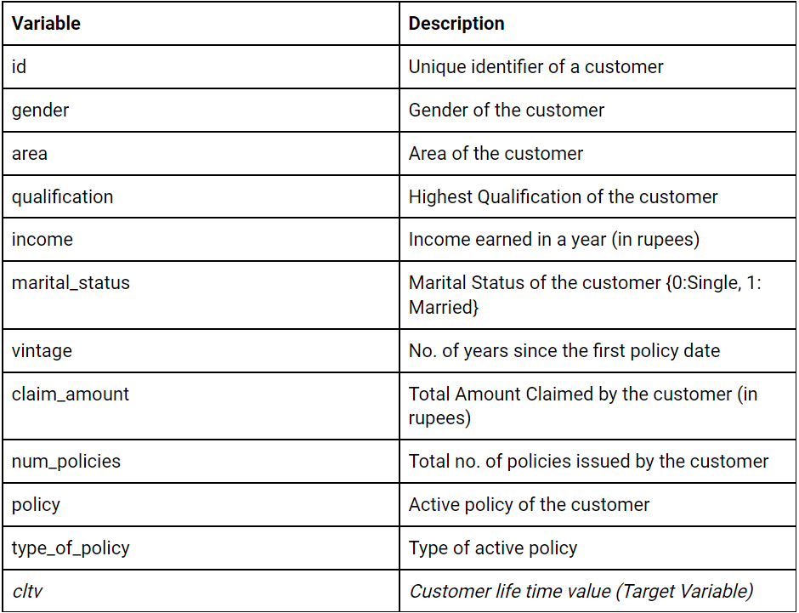
DataSet Details

Slide 4
Data gathering
CSV file
Read into Dataframe

Slide 5
Exploratory Data Analysis [Basic]
There are 89392 Observations of 12 Variable
There are mix of categorical and continuous Datatype.
Dependent Variable is Customer Life Time Value as we have to predict the CLTV.
Dependent variable is continuous so this is a regression problem
Categorical Independent Variables are: ['gender', 'area', 'qualification', 'income', 'num_policies', 'policy', 'type_of_policy']
Continues Independed Variables are : ['id', 'marital_status', 'vintage', 'claim_amount']
There are no null values, so no further action required to replace missing or null values.
“id” column is serial number so it is insignificant for analysis and removed from the dataset.

Slide 6
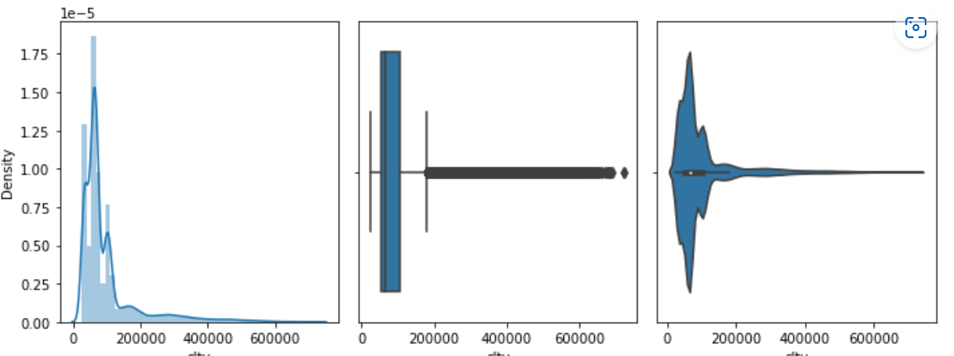
Univariate Analysis [Target]
The CLTV is concentrated below 100,000 thats means based on the customer base, Our firm can expect on an average 70k - 1lakh income business per customer
There are a lot of Customers with low CLV. Very few customers with high CLV.

Slide 7
Univariate Analysis [Categorical]
Male/Female ratio is almost balanced 60:40.
Married/Non-Married ratio is also not that distinguishable.
Majority of vintage customers are 6-7 years old since fist policy
Around 70% customers are urban population.
Most of the customers are having more than 1 policy.
Graduates and Non-Graduates have almost equal proportion.
Almost 60% customers are in higher income bracket.
Mostly customer have chosen policy A.
Platinum policy is most preferred among customers.

Slide 8
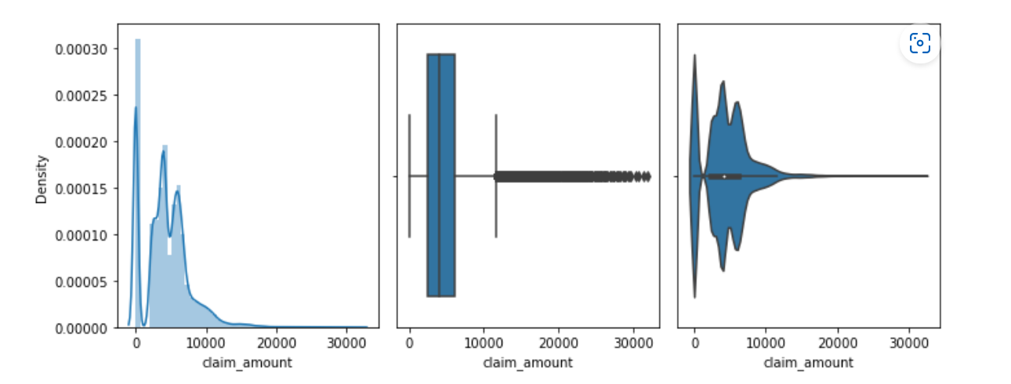
Univariate Analysis [Continuous]
DIstribution is right skewed
Major distribution is observed below 10,000
Some datapoints are extreme indicating one off cases of high claims

Slide 9
Bivariate Analysis [Categorical vs Target]
gender vs cltv: Proportion of both male and female is more or less same for cltv
area vs cltv: Urban population have higher cltv than Rural
num_policies vs cltv: Population with only 1 policy have lower cltv than ones with multiple policies
marital_status vs cltv: Marital status dont have any distinct impact on cltv
qualification vs cltv: High school and above qualification have higher cltv
vintage vs cltv: Higher cltv is returned for 3 years and 8 years old vintage customers
income vs cltv: Above 2 lakh income there is not differentiable impact on cltv
policy vs cltv: Dont observe any pattern or impact of policy on cltv
type_of_policy vs cltv: All policy type have almost equal proportion for cltv

Slide 10
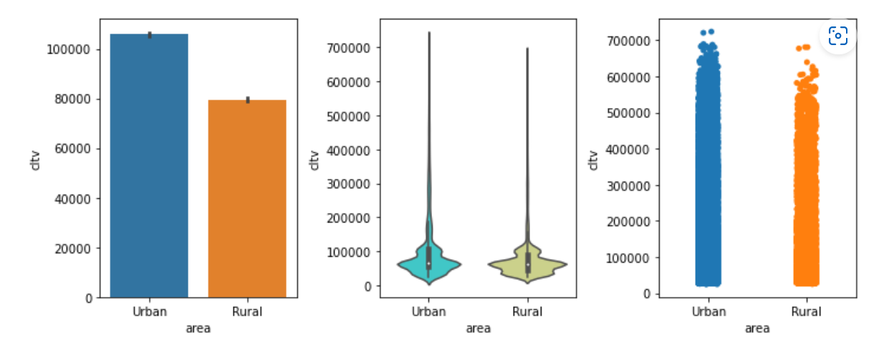
Bivariate Analysis [Categorical vs Target]
Overall, We can conclude that Urban educated population with income > 2lakh and multiple policies have higher cltv.

Slide 11
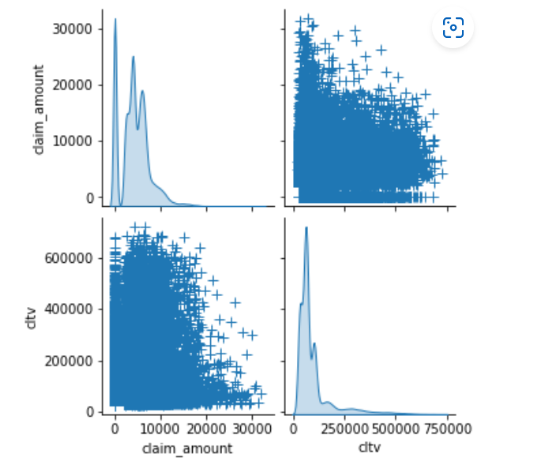
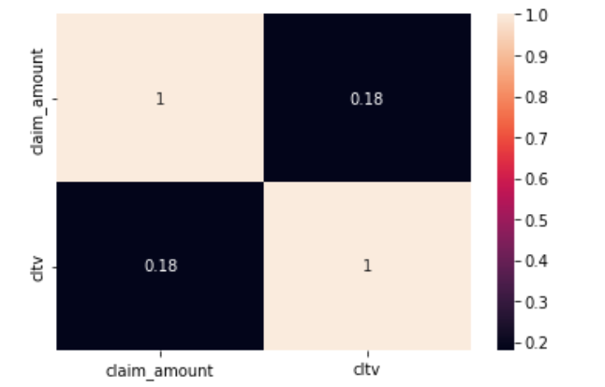
Bivariate Analysis [Continuous vs Target]
claim_amount vs cltv
Not linear in nature
Very little positive correlation

Slide 12
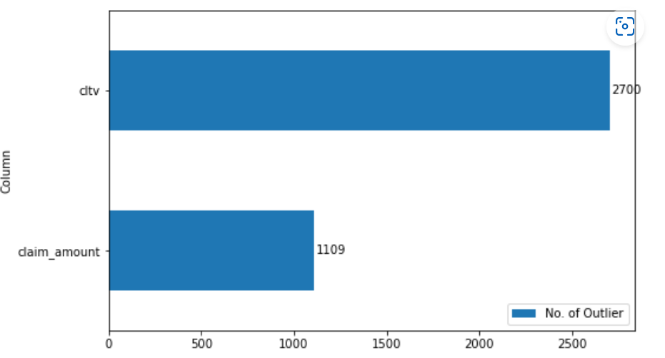
Feature Engineering
Outlier Treatment

Slide 13
Feature Engineering
Outliers can be treated in a variety of ways. It depends on the skewness of the feature.
To reduce right skewness, we use roots or logarithms or reciprocals (roots are weakest). This is the most common problem in practice.
To reduce left skewness, we take squares or cubes or higher powers.
But in our data, some of the features have negative values and also the value 0. In such cases, square root transform or logarithmic transformation cannot be used since we cannot take square root of negative values and logarithm of zero is not defined.
Hence for this data we use a method called Winsorization. In this method we define a confidence interval of let's say 90% and then replace all the outliers below the 5th percentile with the value at 5th percentile and all the values above 95th percentile with the value at the 95th percentile. It is pretty useful when there are negative values and zeros in the features which cannot be treated with log transforms or square roots. Do read up on it more here

Slide 14
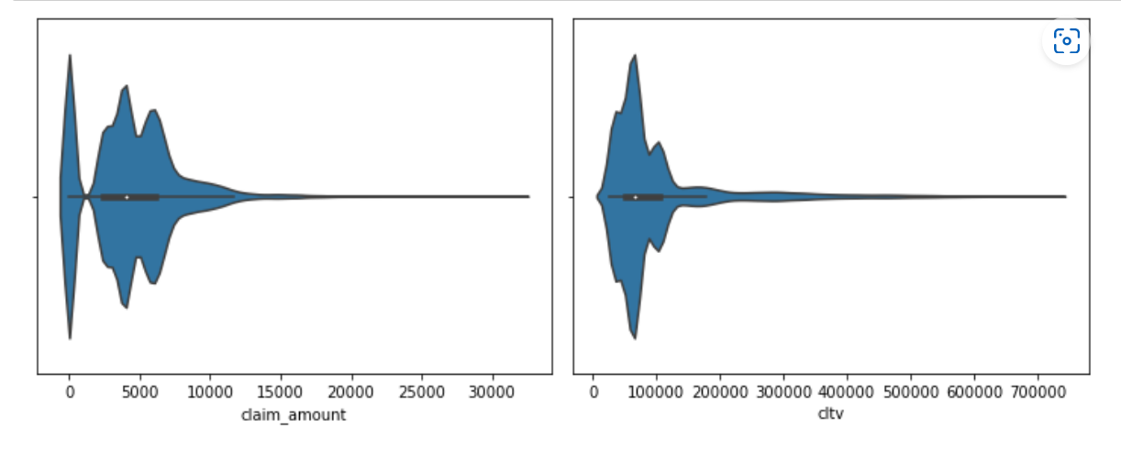
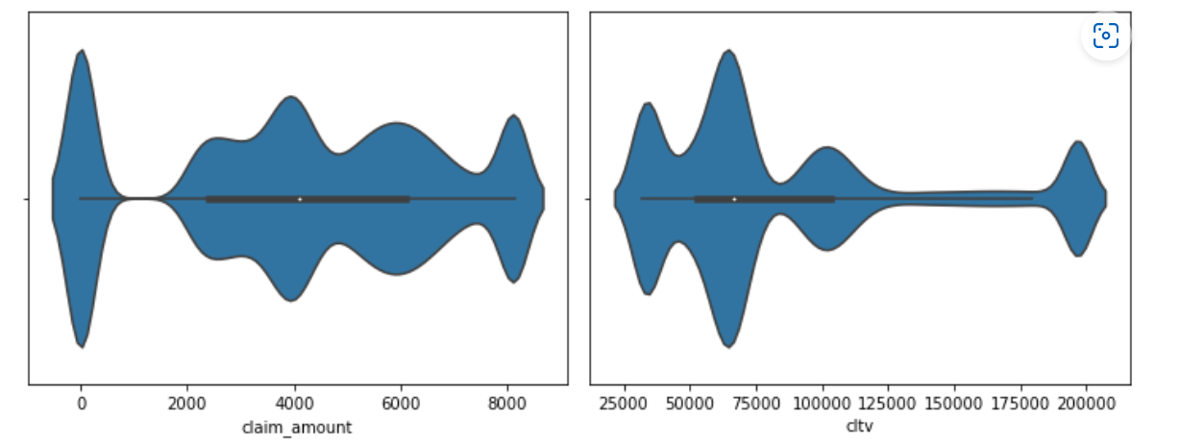
Feature Engineering
Outlier Treatment
Before
After

Slide 15
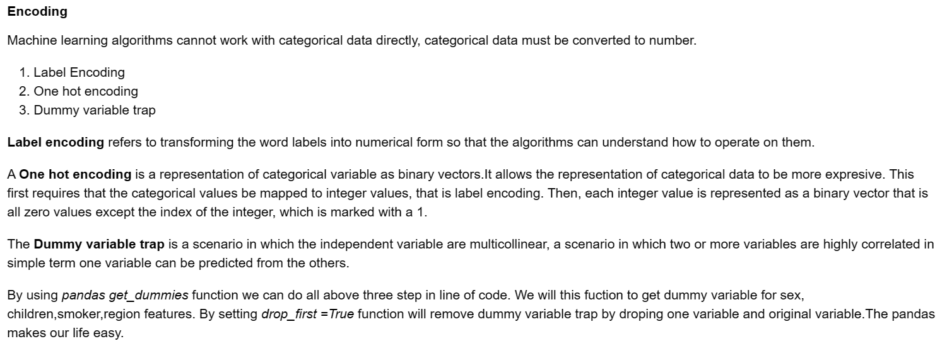
Feature Engineering

Slide 16
Feature Engineering
Feature Scaling
Normalization
Min- Max Scalar
Feature scaling is a method used to standardize the range of independent variables or features of data. In data processing, it is also known as data normalization or standardization. Feature scaling is generally performed during the data pre-processing stage, before training models using machine learning algorithms.

Slide 17
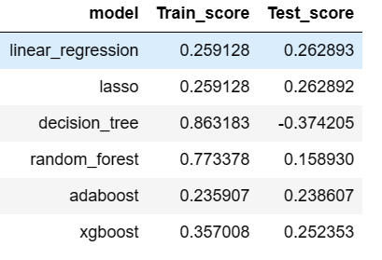
Model Building

Slide 18
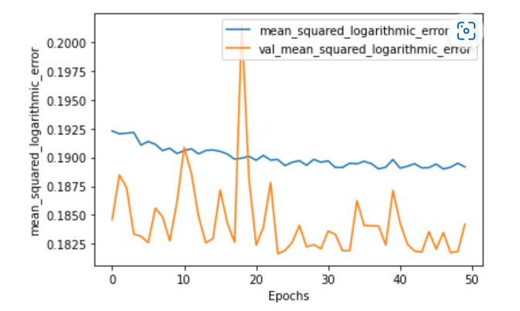
Model Building
ANN

Slide 19
Model Selection
XGBoost provided better R2 score in both training and testing data
Advantages
Inbuilt Regularization
Parallel Processing
Handling missing values
Cross Validation
Effective Tree Pruning

